Slide 1

E-Commerce Fraud Detection Using Machine Learning
Presenter : Aditya Krishna V
Roll no: 64
PRN: 1032211603

Slide 2

Content
1. Introduction E-Commerce Fraud
2. Machine Learning Techniques
3. Benefits and Objectives
4.Literature Review
5. Conclusion

Slide 3




Introduction E-commerce Fraud
Definition of Fraud
E-commerce fraud involves unauthorized and deceptive transactions made online.
Common Types
Identify common types of e-commerce fraud such as identity theft, phishing, and payment fraud.
Impact on Businesses
Discuss the financial and reputational damage caused by e-commerce fraud to businesses.
01
02
03

Slide 4
Types of E-Commerce Fraud
Identity Theft
Fraudsters use stolen personal information to make unauthorized purchases.
Account Takeover
Hackers gain access to user accounts to make fraudulent transactions.
Payment Fraud
Illegitimate use of payment methods to make unauthorized purchases.
01
02
03

Slide 5



Supervised Learning
Training Data
Using labeled data to train the model to classify transactions as fraudulent or legitimate.
Classification Algorithms
Utilizing algorithms like Logistic Regression and Support Vector Machines for fraud detection.
Feature Engineering
Extracting relevant features from transaction data for model training.

Slide 6
Pros and Cons
PROS | CONS
1) Faster Detection | 1) Risk of Overfitting
2) Cost Effective | 2) Data Quality
3) High Accuracy | 3) Adversarial Attacks

Slide 7



Objectives
Preventing Revenue Loss
The primary objective of e-commerce fraud detection is to prevent financial losses resulting from fraudulent transactions, chargebacks, and unauthorized activities.
Protecting Customer Finances
By detecting and preventing fraudulent transactions, businesses aim to protect their customers from financial losses and identity theft, fostering trust and loyalty.
Safeguarding Business Reputation
Effective fraud detection contributes to maintaining a positive brand reputation and instilling confidence in the security of e-commerce platforms.

Slide 8
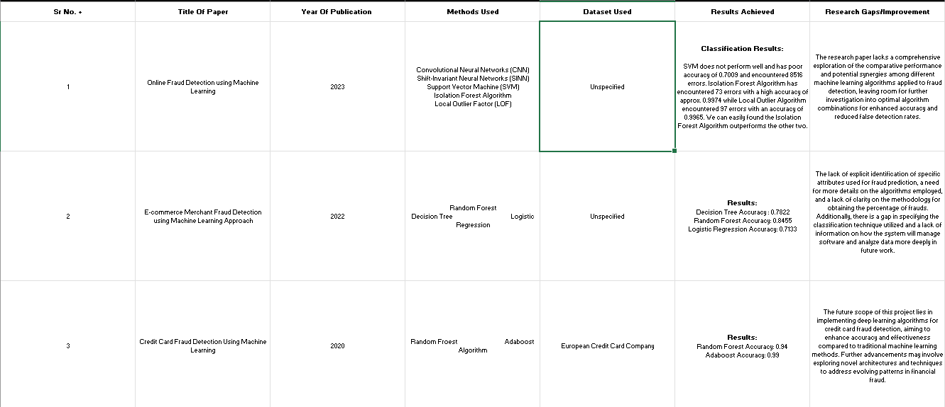
Literature Survey

Slide 9
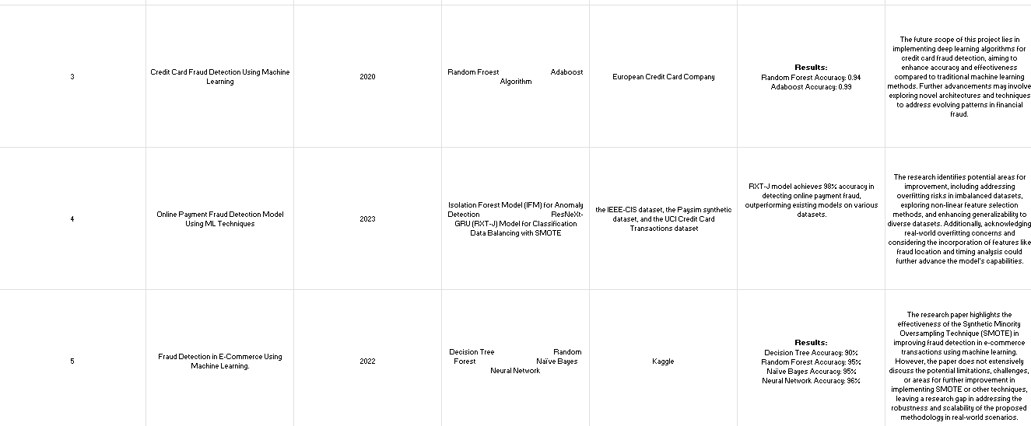
Literature Survey

Slide 10
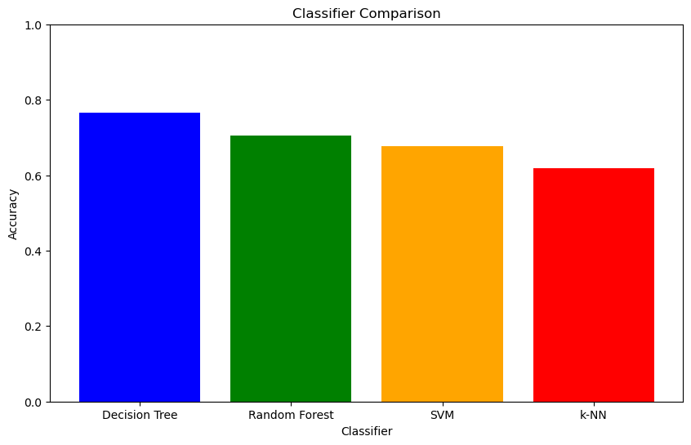
Results

Slide 11
Conclusion: Safeguarding E Commerce
Proactive measures are key to ensuring safe digital transactions.
Advanced tech and teamwork enhance our defense against changing threats.

Slide 12

Thank You

